Slide 1
STEP 03: 다중 에이전트 개발하기
Microsoft Agent Framework

Slide 2
추가 에이전트 생성하기

Slide 3



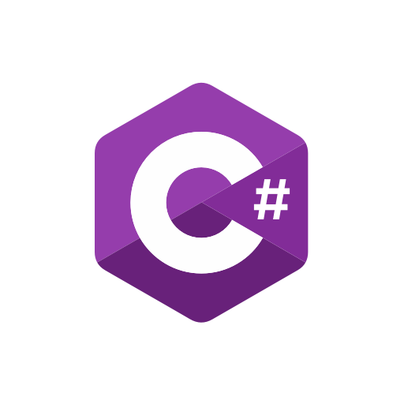

Microsoft Agent Framework
Semantic Kernel
AutoGen
Full SDK designed to build AI agents with ease, excellent for single agents and can be extended for multi-agents with integrations to AutoGen
Powerful multi-agent research framework with pre-built conversation orchestration patterns for handling complex agent systems

Slide 4
Microsoft Agent Framework
Semantic Kernel
AutoGen
Full SDK designed to build AI agents with ease, excellent for single agents and can be extended for multi-agents with integrations to AutoGen
Powerful multi-agent research framework with pre-built conversation orchestration patterns for handling complex agent systems

Slide 5
…
builder.AddAIAgent("writer");
builder.AddAIAgent(
"editor",
new ChatClientAgent(
…
tools: [ AIFunctionFactory.Create(…) ]
)
);
…

Slide 6
…
builder.AddAIAgent("writer");
builder.AddAIAgent(
"editor",
new ChatClientAgent(
…
tools: [ AIFunctionFactory.Create(…) ]
)
);
…

Slide 7
…
builder.AddAIAgent("writer");
builder.AddAIAgent(
"editor",
new ChatClientAgent(
…
tools: [ AIFunctionFactory.Create(…) ]
)
);
…

Slide 8
직접 AI Tooling을 만들어서 연결할 수 있습니다

Slide 9
다중 에이전트 워크플로우 구성하기

Slide 10

다중 에이전트 워크플로우 패턴
Sequential
Concurrent
Handoff
Group Chat
Magentic
worker
reviewer

Slide 11
다중 에이전트 워크플로우 패턴
Sequential
Concurrent
Handoff
Group Chat
Magentic
worker
reviewer

Slide 12
다중 에이전트 워크플로우 패턴
Sequential
Concurrent
Handoff
Group Chat
Magentic
worker
reviewer

Slide 13
다중 에이전트 워크플로우 패턴
Sequential
Concurrent
Handoff
Group Chat
Magentic
worker
reviewer

Slide 14
다중 에이전트 워크플로우 패턴
Sequential
Concurrent
Handoff
Group Chat
Magentic
worker
reviewer

Slide 15
다중 에이전트 워크플로우 패턴
Sequential
Concurrent
Handoff
Group Chat
Magentic
worker
reviewer

Slide 16
Microsoft Agent Framework
Semantic Kernel
AutoGen
Full SDK designed to build AI agents with ease, excellent for single agents and can be extended for multi-agents with integrations to AutoGen
Powerful multi-agent research framework with pre-built conversation orchestration patterns for handling complex agent systems

Slide 17
Microsoft Agent Framework
Semantic Kernel
AutoGen
Full SDK designed to build AI agents with ease, excellent for single agents and can be extended for multi-agents with integrations to AutoGen
Powerful multi-agent research framework with pre-built conversation orchestration patterns for handling complex agent systems

Slide 18
…
builder.AddAIAgent("writer");
builder.AddAIAgent("editor");
builder.AddWorkflow(
"publisher",
AgentWorkflowBuilder.BuildSequential(
"publisher",
[ writer, editor ]
)
).AddAsAIAgent();
…

Slide 19
…
builder.AddAIAgent("writer");
builder.AddAIAgent("editor");
builder.AddWorkflow(
"publisher",
AgentWorkflowBuilder.BuildSequential(
"publisher",
[ writer, editor ]
)
).AddAsAIAgent();
…

Slide 20
…
builder.AddAIAgent("writer");
builder.AddAIAgent("editor");
builder.AddWorkflow(
"publisher",
AgentWorkflowBuilder.BuildSequential(
"publisher",
[ writer, editor ]
)
).AddAsAIAgent();
…

Slide 21
…
builder.AddAIAgent("writer");
builder.AddAIAgent("editor");
builder.AddWorkflow(
"publisher",
AgentWorkflowBuilder.BuildSequential(
"publisher",
[ writer, editor ]
)
).AddAsAIAgent();
…

Slide 22
…
builder.AddWorkflow("publisher",
AgentWorkflowBuilder.BuildSequential(
"publisher",
[ writer, editor ]
)
).AddAsAIAgent();
…
app.MapAGUI("ag-ui", publisher);
…

Slide 23
…
builder.AddWorkflow("publisher",
AgentWorkflowBuilder.BuildSequential(
"publisher",
[ writer, editor ]
)
).AddAsAIAgent();
…
app.MapAGUI("ag-ui", publisher);
…

Slide 24
에이전트 응답 필터링

Slide 25
에이전트 응답 중 필요한 부분만 필터링

Slide 26
Writer 에이전트
Editor 에이전트
Publisher 워크플로우

Slide 27
실습 시작

Slide 28
aka.ms/agentframework/workshop/ko
STEP 03

Slide 29
Microsoft branding slide

